Slide 1
Chapter 10
ASSOCIATION RULES
Cios / Pedrycz / Swiniarski / Kurgan

Slide 2
Outline
Introduction
Association Rules and Transactional Data
  Basic Concepts
Mining Single Dimensional, Single-Level Boolean Association Rules
  Naïve Algorithm
  Apriori Algorithm
  Generating Association Rules from Frequent Itemsets
  Improving Efficiency of the Apriori Algorithm
  Finding Interesting Association Rules

Slide 3
Introduction
Association rules mining is another, after clustering, key unsupervised data mining method that finds interesting associations (relationships, dependencies) in large sets of data items.

Slide 4
Introduction
AR are used to describe associations or correlations among a set of items in transaction databases, relational databases, and data warehouses
  applications:
    basket data analysis, cross-marketing, catalog design, clustering, data preprocessing, genomics, etc.
  - rule format: LHS ⇒ RHS [support, confidence]
  Examples:
  buys(x, diapers) ⇒ buys(x, beers) [0.5%, 60%]
  major(x, CS) AND takes(x, Advanced Data Analysis) ⇒ level(x, PhD) [1%, 75%]

Slide 5
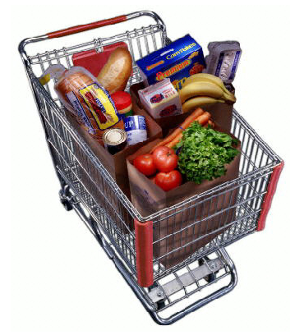
Introduction
in this shopping basket customer bought tomatoes, carrots, bananas, bread, eggs, sup, milk, etc.
how the demographical information affects what the customer buys?
is bread usually bought with milk?
does a specific milk brand make any difference?
where we place the tomatoes in the store to maximize their sales?
what can be learned using association rules?
is the bread bought when both milk and eggs are bought together?

Slide 6
Introduction
AR can be derived when data describes events that occur at the same time / in close proximity.
They can be:
  useful, when containing high quality, actionable information
    diapers ⇒ beer
  trivial, when they are valid and supported by data, but useless since they describe well known facts
    milk ⇒ eggs
  inexplicable, when they concern valid and new facts, but they cannot be utilized
    grocery store ⇒ milk is sold as often as bread

Slide 7
Introduction
Some of the common applications:
  planning store layouts
    we can place products that have a strong purchasing relationship close together OR
    we place such products far apart to increase traffic to purchase other items
  planning bundling products and offering coupons
    knowing that buys(x, diapers) ⇒ buys(x, beers), discounts are not offered on both beer and diapers at the same time
      we discount one to increase sales and make money on the other
  designing direct marketing campaign
    mailing a camcorder promotion to people who bought VCR is best when it comes approximately two to three months after the VCR purchase
  other applications will be discussed later…

Slide 8
Introduction
How do we derive ARs:
  techniques are based on probability and statistics
  the process consists of 4 steps
    prepare input data
    choose items of interest… (itemset)
    compute probabilities, joint probabilities, etc…
    find (the most probable) association rules…

Slide 9
Transactional Data
Data should be provided in transactional form
  each record consists of transaction ID and information about all items that constitute the transaction
TID | Transaction (basket)
1000 | Beer, Diapers, Eggs
… | ….
Transaction ID
Subset of all available items

Slide 10
Transactional Data
First look at the transactional data
  example
  rules (just by looking at the data)
    Beer ⇒ Eggs
    Apples ⇒ Celery
TID | Transaction (basket)
1000 | Apples, Celery, Diapers
2000 | Beer, Celery, Eggs
3000 | Apples, Beer, Celery, Eggs
4000 | Beer, Eggs

Slide 11
Transactional Data
Nominal data can also be transformed into transactions
  transformed into transactional format
Example | Attributes |  |  |  |  | Target Attribute
 | Bar | Fri/Sat | Hungry | Rain | Estimate | Wait?
e₁ | No | No | Yes | No | 0-10 | Yes
… | … | … | … | … | … | …
TID | Transaction (basket)
1 | Bar=No, Fri/Sat=No, Hungry=Yes, Rain=No, Estimate=0-10, Wait?=Yes
… | ….
Notes:
As an exercise, transform example 2. This kind of transformation is used in the Witten and Frank book.

Slide 12
Association Rules
What do we want to do?
  given database of transactions, where each transaction is a list of items (purchased by a customer in a visit)
  find all rules that correlate presence of one set of items with that of another set of items
    how many items do we consider in each set?
    how do we define correlation?
      how strong the correlation should be?
    how do we extract useful rules?
  Let us answer these questions

Slide 13
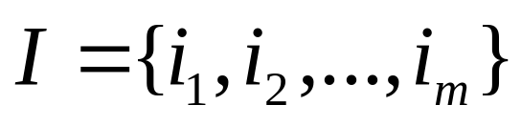
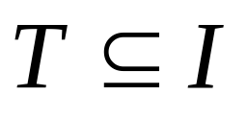
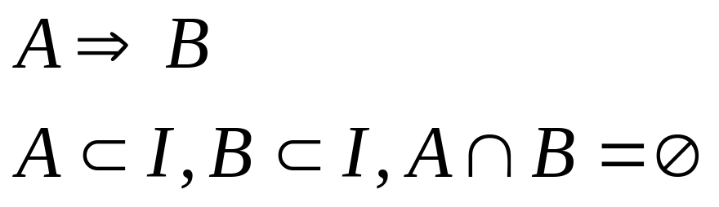

Basic Definitions
itemset
transaction
association rule
dataset (set of transactions)

Slide 14
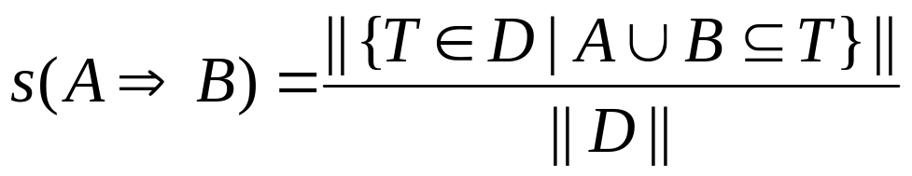
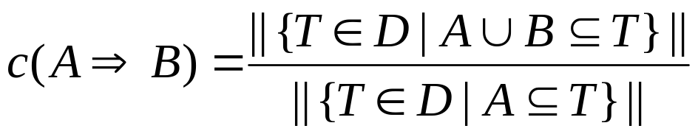
Basic Definitions
How to measure interestingness of the rules?
  each rule has two assigned measures
    support which indicates the frequencies of the occurring patterns
      defined as ratio of # of transactions containing A and B to the total # of transactions
    confidence which denotes the strength of implication in the rule
      defined as ratio of # of transactions containing A and B to the #of transactions containing A

Slide 15
Basic Definitions
How to measure interestingness of the rules?
  example: diapers ⇒ beer
    support
    confidence
customer
buys beer
customer
buys both
customer
buys diapers

Slide 16
Basic Definitions
How to measure interestingness of the rules?
    let’s use a more complex rule and explain the concepts in terms of probabilities
      find all the rules A and B ⇒ C with minimum confidence and support
        support is probability that a transaction contains {A, B, C}
        confidence is conditional probability that a transaction having {A, B}, also contains C
        A and B ⇒ C (support is 25%, confidence is 100%)
        if we decide to have minimum support of 50% and minimum confidence of 50%, we generate two rules from the data:
        A ⇒ C (support 50%, confidence 66.6%)
        C ⇒ A (support 50%, confidence 100%)
TID | Transaction
1 | A, B, C
2 | A, C
3 | A, D
4 | B, E, F

Slide 17
Basic Definitions
TID | Transaction (basket)
1000 | Apples, Celery, Diapers
2000 | Beer, Celery, Eggs
3000 | Apples, Beer, Celery, Eggs
4000 | Beer, Eggs
What is I?
What is T for TID=2000?
What is support(Beer ⇒ Eggs)?
What is confidence(Beer ⇒ Eggs)?

Slide 18
Basic Definitions
TID | Transaction (basket)
1000 | Apples, Celery, Diapers
2000 | Beer, Celery, Eggs
3000 | Apples, Beer, Celery, Eggs
4000 | Beer, Eggs
What is I?
  Apples, Beer, Celery, Diapers, Eggs m (# of items) = 5
What is T for TID=2000?
  Beer, Celery, Eggs
What is support(Beer ⇒ Eggs)?
  3/4 = 75%
What is confidence(Beer ⇒ Eggs)?
  3/3 = 100%

Slide 19
Basic Definitions
Frequent itemsets
  itemset is any set of items
  k-itemset is an itemset containing k items
  frequent itemset is an itemset that satisfies a minimum support level
  the problem arises when we try to analyze dataset that contains m items
    how many itemsets are there?
      many if m is large
Notes:
There are 2^m itemsets, the number of subsets of a set (or the cardinality of the power set)

Slide 20
Strong Association Rules
Given an itemset it is easy to generate association rules
  Example itemset = {Beer, Diapers}:
    ⇒ Beer, Diapers
    Beer ⇒ Diapers
    Diapers ⇒ Beer
    Diapers, Beer ⇒
  we are interested only in strong rules
    those which satisfy minimum support and minimum confidence
      these two are user-defined parameters

Slide 21
Strong Association Rules
Given itemsets, it is easy to generate association rules
  example itemsets:
  {Beer, Diapers} with support 40%
  {Beer, Diapers, Eggs} with support 20%
  rule
  IF customer buys Beer and Diapers THEN the probability that (s)he buys Eggs is 50% can be inferred
    This provides simple descriptive pattern

Slide 22
Association Rules
How to generate ARs?
  two basic steps
    Find all frequent itemsets
      those that satisfy minimum support
    Find all strong association rules
      generate association rules from frequent itemsets
      select and keep rules that satisfy minimum confidence

Slide 23
Naïve Algorithm
How do we generate frequent itemsets (step 1)?
  naïve algorithm
  n = |D|
  for each subset s of I
  {
  counter = 0
  for each transaction T in D
  {
  if s is a subset of T
  counter = counter + 1
  }
  if minimum support ≤ counter / n
  add s to frequent itemsets
  }

Slide 24
Frequent Itemsets
Does the naïve algorithm work well?
    we have 2^{m} subsets of I
    we have to scan n transactions for each subset
  thus we perform O(2^{m}n) tests
  O(2^{m}n) complexity shows that
    the algorithm growth exponentially with the number of items m
    Thus we have to use some other approach!

Slide 25
Frequent Itemsets
FIs support the apriori property
  if A is not a frequent itemset, then any superset of A is not a frequent itemset
    we will use this property to speed up the computations
  Proof
    n is # of transactions
    suppose A is a subset of i transactions
    if A’ ⊂ A, then A’ is a subset of i’ ≤ i transactions
    thus
    if i/n < minimum support, so is i’/n
Notes:
The proof is because A’ contains A, so if A’ is a subset of a transaction, then A is also a subset of the transaction.

Slide 26
Frequent Itemsets
Using the apriori property
  candidate k-itemsets are build from frequent (k-1)-itemsets
    find all frequent 1-itemsets
    extend (k-1)-itemsets to candidate k-itemsets
    prune candidate itemsets that do not meet the minimum support requirement

Slide 27
Apriori Algorithm
Improved algorithm to generate frequent itemsets
L₁ = {frequent 1-itemsets}
for (k=2; L_{(k-1)} is not empty; k++)
{
C_{k} is generated as k-itemset candidate from L_{(k-1)}
for each transaction T in D
{
C_{t}=subset(C_{k},T) // k-itemsets that are subsets of T
for each k-itemset c in C_{t}
c.count++;
}
L_{k} = {c in C_{k} such that c.count ≥ minimum support}
}
the frequent itemsets are the union of the L_{k}

Slide 28
Frequent Itemsets
L₁ = {frequent 1-itemsets}
for (k=2; L_{(k-1)} is not empty; k++)
{
C_{k} is generated as k-itemset candidates from L_{(k-1)}
for each transaction T in D
{
C_{t}=subset(C_{k},T) // candidates that are subsets of T
for each candidate c in C_{t}
c.count++;
}
L_{k} = {c in C_{k} such that c.count ≥ minimum suport}
}
the frequent itemsets are the union of the L_{k}
Apriori approach reduces number of considered itemsets (# of scans of D)
  how do we generate k-itemset candidates?
    for each item i that is not in a given frequent (k-1)-itemset, but in some other frequent (k-1) itemset in L_{k-1}
      add i to the (k-1)-itemset to create a k-itemset candidate
      remove duplicates
        example
        frequent 1-itemsets {A}, {B}, {C}
        candidate 2-itemsets {A, B}, {A, C}, {B, A}, {B, C}, {C, A}, {C, B}
        eliminate duplicates {A, B}, {A, C}, {B, C}
    joining together frequent (k-1)-itemsets
      if frequent (k-1)-itemsets have (k-2)-items in common, create a k-itemset candidate by adding two different items to (k-2) common items
        example
        {A, B, C} joined with {A, B, D} gives {A, B, C, D}

Slide 29
Association Rules
Find all frequent itemsets
  those that satisfy minimum support
Find all strong association rules
  generate association rules from frequent itemsets
  select and keep rules that satisfy minimum confidence
The frequent set is computed iteratively
  1st iteration
    large 1-candidate itemsets are found by scanning
  k^{th} iteration
    large k-candidate itemsets are generated by applying apriori-based generation to large (k-1)-itemsets
    apriori rule generates only those k-itemsets whose every
    (k-1)-itemset subset is frequent (above the threshold)
Generating rules
  for each frequent itemset X output all rules
  Y ⇒ (X – Y) if s(X) / s(Y) > minimum confidence
    Y is a subset of X

Slide 30
Example
We will generate association rules from the transactional data given below:
  minimum support = 50%
    the # of transactions above the minimum support is 4 x 50 % = 2
  minimum confidence = 60%
⇒
TID | Transaction
1000 | Apples, Celery, Diapers
2000 | Beer, Celery, Eggs
3000 | Apples, Beer, Celery, Eggs
4000 | Beer, Eggs
TID | Transaction
1000 | A, C, D
2000 | B, C, E
3000 | A, B, C, E
4000 | B, E

Slide 31
Example
L₁
TID | Transaction
1000 | A, C, D
2000 | B, C, E
3000 | A, B, C, E
4000 | B, E
itemset | support count
A | 2
B | 3
C | 3
D | 1
E | 3
C₁
itemset | support count
A | 2
B | 3
C | 3
E | 3
generate candidate 1-itemsets
generate frequent 1-itemsets
delete candidates below minimum support
itemset | support count
A, B | 1
A, C | 2
A, E | 1
B, C | 2
B, E | 3
C, E | 2
C₂
itemset | support count
A, C | 2
B, C | 2
B, E | 3
C, E | 2
L₂
generate candidate 2-itemsets
generate frequent 2-itemsets
we do not use 3-itemsets with (A, B) and (A, E)
they are below minimum support
C₃
itemset | support count
B, C, E | 2
itemset | support count
B, C, E | 2
generate candidate 3-itemsets
generate frequent 3-itemsets
L₃

Slide 32
Example
TID | Transaction
1000 | A, C, D
2000 | B, C, E
3000 | A, B, C, E
4000 | B, E
Finally we derive association rules
from generated frequent 3-itemset {B, C, E} with s = 50%
  we need to satisfy minimum confidence of 60%
  B and C ⇒ E with support = 50% and confidence = 100%
  B and E ⇒ C with support = 50% and confidence = 66.7%
  C and E ⇒ B with support = 50% and confidence = 100%
  B ⇒ C and E with support = 50% and confidence = 66.7%
  C ⇒ B and E with support = 50% and confidence = 66.7%
  E ⇒ B and C with support = 50% and confidence = 66.7%

Slide 33
Improving Efficiency of Apriori
The Apriori algorithm can be modified to improve its efficiency (computational complexity) by:
  hashing
  removal of transactions that do not contain frequent itemsets
  sampling of the data
  partitioning of the data
  mining frequent itemsets without generation of candidate itemsets

Slide 34
Improving efficiency: Hashing
Hashing
  is used to reduce the size of the candidate k-itemsets, i.e., itemsets that are generated from frequent itemsets from iteration k-1, C_{k}, for k>1
    for instance, when scanning D to generate L₁ from the candidate 1-temsets in C₁, we can at the same time generate all 2-itemsets for each transaction, hash (map) them into different buckets of the hash table structure and increase the corresponding bucket counts
    a 2-itemset, which corresponding bucket count is below the support threshold, cannot be frequent and thus we can remove it from the candidate set C₂.
    In this way we reduce the number of candidate 2-itemsets that must be examined to obtain L₂

Slide 35
Improving efficiency: Hashing
To add itemset, start at root and go down until a leaf is reached
At interior node at depth d, decide which branch to follow by applying hash function to the dth item of the itemset
When # of items in a leaf node exceeds some threshold convert leaf node to an internal node

Slide 36
Improving efficiency: Hashing
To find candidates contained in given transaction, t
  Hash on every item in t at the root node
    to ensure that itemsets that start with an item not in t are ignored
  At interior node reached by hashing the item i in the transaction hash on each item that comes after i in t

Slide 37
Improving efficiency: Hashing
Let C₃ = {{1 2 3}, {1 2 4}, {1 3 4}, {1 3 5}, {2 3 4}}
C_{t} = subset(C₃, {1 0 1 1 0})
First build hash-tree with candidate itemsets
Then determine which of those itemsets are actually in the given transaction

Slide 38
Hash-Tree
At root (d=1), hash on items in t: 1, 3, 4. 3, 4 return nothing since no itemsets start with 3 or 4. 2 Is ignored since not in t.
t = {1 0 1 1 0}
ROOT
d = 2
Hash on the next item in t: 3, ignore itemsets with 2 since not in t.
1
2
{2 3 4}
Hash
Table
2
3
Check which are in t. Those that are get added to C_{t} as output from subset function.
{1 2 3}
{1 2 4}
{1 3 4}
{1 3 5}
C_{t} = {1 3 4}
Manually verify that of the 5 itemsets in C₃ only {1 3 4} was actually present in the transaction

Slide 39
Improving Efficiency of Apriori
Removal of transactions that do not contain frequent itemsets
  we remove transactions that do not contain frequent itemsets
  In general, if a transaction does not contain any frequent k-itemsets, it cannot contain any frequent (k+1) itemsets, and thus can be removed from computation of any frequent t-itemsets, where t > k

Slide 40
Improving Efficiency of Apriori
Sampling of the data
  we generate association rules based on a sampled subset of transactions in D
    a randomly selected subset S of D is used to search for the frequent itemsets
    generation of frequent itemsets from S is more efficient (faster) but some of the rules that would have been generated from D may be missing, and some rules generated from S may not be present in D

Slide 41
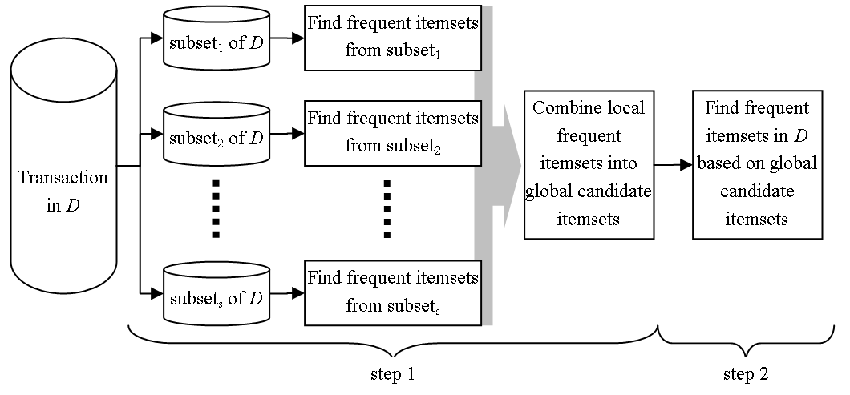
Improving Efficiency of Apriori
Partitioning of the data
  partitioning generates frequent itemsets by finding frequent itemsets in subsets (partition) of D

Slide 42
Improving Efficiency of Apriori
Mining frequent itemsets without generation of candidate itemsets
  one of the main limiting aspects of the Apriori is that it can generate very large number of candidate itemsets
    for instance, for 10,000 1-itemsets, the Apriori algorithm generates approximately 10,000,000 candidate 2-itemsets
  other limiting aspect is that the Apriori may need to repeatedly scan the data set D
  to address these issues, a divide-and-conquer method, which decomposes the overall problem into a set of smaller tasks, is used
    the method, referred to as frequent-pattern growth (FP-growth) compresses the set of frequent (individual) items from D into a frequent pattern tree (FP-tree)

Slide 43
Finding Interesting Association Rules
Depending on the minimum support and confidence values the user may generate a large number of rules to analyze and assess
How to filter out the rules that are potentially the most interesting?
  whenever a rule is interesting (or not) can be evaluated either objectively or subjectively
    the ultimate but subjective user’s evaluation cannot be quantified or anticipated; they are different for different users
    that is why objective interestingness measures, based on the statistical information present in D are used

Slide 44
Finding Interesting Association Rules
The subjective evaluation of association rules often boils down to checking if a given rule is unexpected (i.e., surprises the user) and actionable (i.e., the user can use it for something useful)
  useful, when they provide high quality actionable information
  e.g. diapers ⇒ beers
  trivial, when they are valid and supported by data but useless since they confirm well known facts
  e.g. milk ⇒ bread
  inexplicable, when they contain valid new facts but cannot be utilized
  e.g. grocery_store ⇒ milk_is_sold_as_often_as_bread

Slide 45
Finding Interesting Association Rules
In most cases, confidence and support values associated with each rule are used as the objective measure to select the most interesting rules
  rules that have these values higher with respect to other rules are preferred
  although this simple approach works in many cases, we will show that sometimes rules with high confidence and support may be uninteresting or even misleading

Slide 46
Finding Interesting Association Rules
Objective interestingness measures
  example
    let us assume that transactional data contains milk and bread as the frequent items
    2,000 transactions were recorded
      in 1,200 customers bought milk
      in 1,650 customers bought bread
      in 900 customers bought both milk and bread
 | milk | not milk | total
bread | 900 | 750 | 1650
not bread | 300 | 50 | 350
total | 1200 | 800 | 2000

Slide 47
Finding Interesting Association Rules
Objective interestingness measures
  Example
    given the minimum support threshold of 40% and minimum confidence threshold of 70% rule
    “milk ⇒ bread [45%, 75%]” would be generated
    on the other hand, due to low support and confidence values the rule “milk ⇒ not bread [15%, 25%]” would not be generated
    the latter rule is by far more “accurate” while the first may be misleading

Slide 48
Finding Interesting Association Rules
Objective interestingness measures
  example
    “milk ⇒ bread [45%, 75%]” rule
      probability of buying bread is 82.5%, while confidence of
      milk ⇒ bread is lower and equals 75%
      bread and milk are negatively associated, i.e., buying one decreases buying the other
      obviously using this rule would not be a wise decision
 | milk | not milk | total
bread | 900 | 750 | 1650
not bread | 300 | 50 | 350
total | 1200 | 800 | 2000

Slide 49
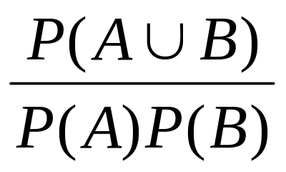
Finding Interesting Association Rules
Objective interestingness measures
  alternative approach to evaluate interestingness of association rules is to use measures based on correlation
  for A ⇒ B rule, the itemset A is independent of the occurrence of the itemset B if P(A ⇒ B) = P(A)P(B). Otherwise, itemsets A and B are dependent and correlated as events.
  correlation measure (also referred to as lift and interest), is defined between itemsets A and B as

Slide 50
Finding Interesting Association Rules
Objective interestingness measures
  correlation measure
    if the correlation value is less than 1, then the occurrence of A is negatively correlated (inhibits) the occurrence of B
    if the value is greater than 1, then A and B are positively correlated, which means that occurrence of one promotes occurrence of the other
    if correlation equals 1, then A and B are independent, i.e., there is no correlation between these itemsets
      correlation value for the rule milk ⇒ bread is
      0.45 / (0.6*0.825) = 0.45 / 0.495 = 0.91

Slide 51
Applications
Web Personalization
  personalization and recommendation systems for browsing web pages
    e.g. Amazon’s recommended books
    Mobasher, et al., Effective Personalization Based on Association Rule Discovery from Web Usage Data, ACM Workshop on Web Information and Data Management, 2001
Genomic Data
  mining to find associations in genomic data
    Satou, K., et al., Finding Association Rules on Heterogeneous Genome Data, Proceedings of the Pacific Symposium on Biocomputing, pp.397-408, pp.1997

Slide 52
Genomic Data
Summary of results
  182,388 association rules were generated with
    minimum support = 5%
    minimum confidence = 65%
  post processing of the generated rules selected rules with maximum support of 30
    final number of generated rules was 381
      they were corroborated by biological data
        common substructures in serine endopeptidases were found

Slide 53
References
R. Agrawal, T. Imielinski, and A. Swami, Mining Association Rules Between Sets of Items in Large Databases, Proceedings of the ACM SIGMOD Conference on Management of Data, pp. 207-216, 1993
R. Agrawal, and R. Srikant, Fast Algorithms for Mining Association Rules, Proceedings of the 20th VLDB Conference, pp. 487-499, 1994
J. Han, M. Kamber, Data Mining, Morgan Kaufmann, 2001
More references:
http://public.rz.fh-wolfenbuettel.de/~hoeppnef/bib/keyword/ASSOCIATION-RULES.html

